Slide 1
DocumentDB

Slide 2
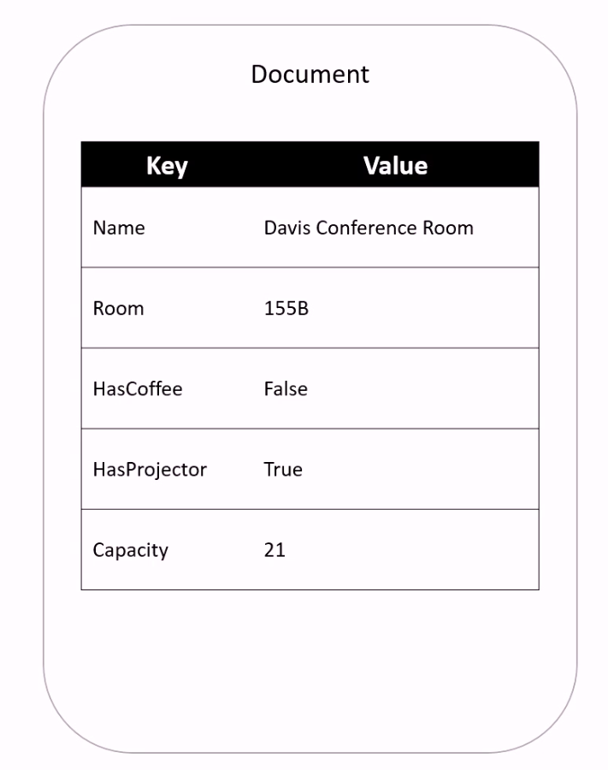
Key-Value

Slide 3
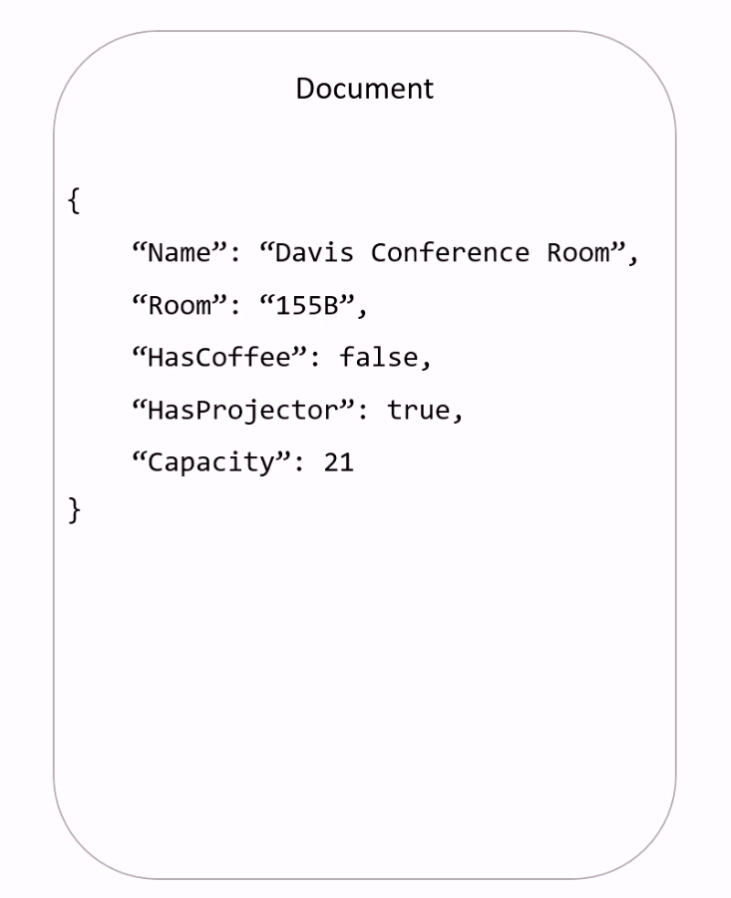
Key-Value

Slide 4
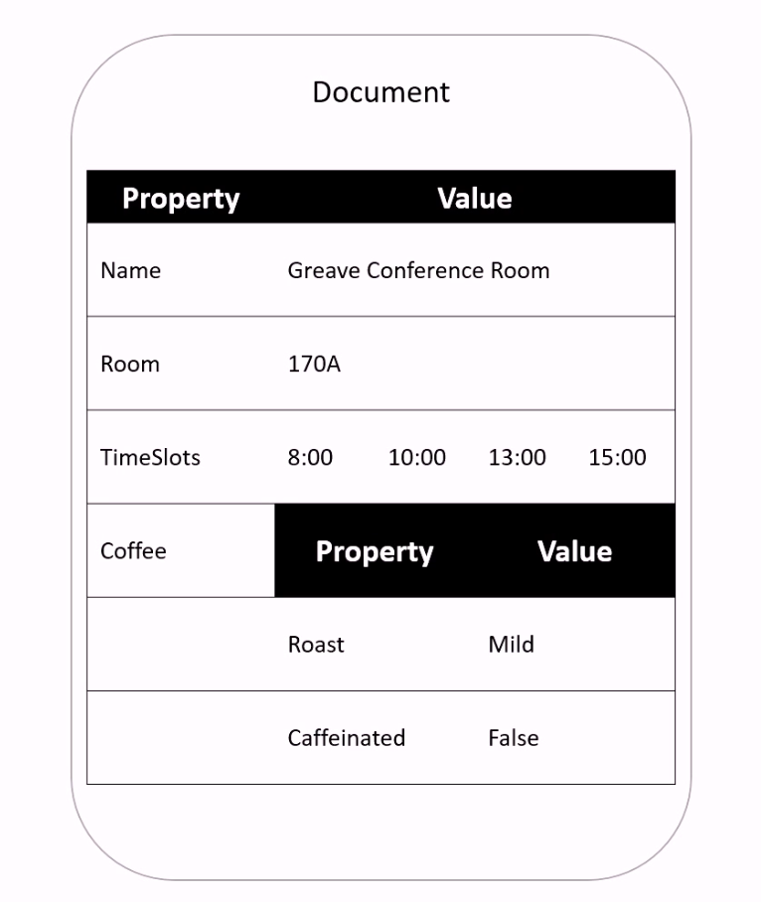
Document

Slide 5
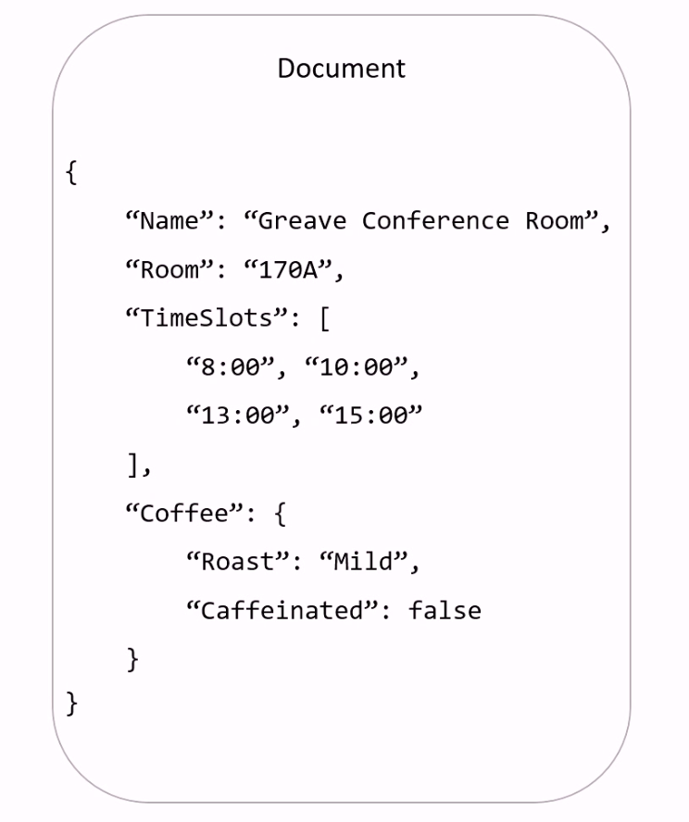
Document

Slide 6
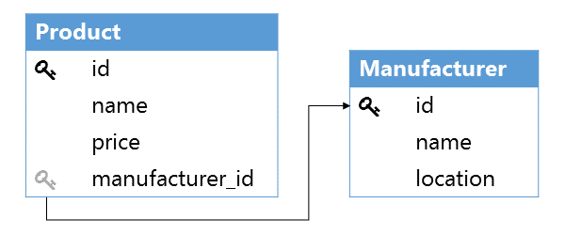
Modeling Complex Structures

Slide 7
Modeling Complex Structures
{
"id": "12345",
"name": "Pedals",
"price": 50.00,
"manufacturer": {
"name": "Mountain Acc",
"location": "San Diego"
}
}
[
{
"id": "12345",
"name": "Pedals",
"price": 50.00,
"manufacturer_id": "67890"
},
{
"id": "67890",
"name": "Mountain Acc",
"location": "San Diego"
}
]
Denormolized
Normolized

Slide 8
Quiz
What is the main difference between Document and Key-Value storages?
In which scenarios we should use denormolized form?
In which scenarios we should use normalized form?

Slide 9
Vocabulary
Word | Definition | Examples
dispensable | more than you need and therefore not necessary; that can be got rid of | It seemed the soldiers were regarded as dispensable - their deaths just didn't matter.
bloat | to swell up, or to make someone or something swollen: | If I eat it, my stomach bloats up.

